Slide 1

IIT Gandhinagar
Summer Project
Under the guidance of Prof. Hari Ganesh
Dablu Kumar | 20110049
B. Tech | Chemical Eng.

Slide 2
Introduction
As we know, the global population is increasing rapidly, and therefore the consumption of food, energy, and water is also increasing. Water, energy and food can be regarded as common resources, that can be overused and under-maintained if we try to tackle.
Water, energy and food are interconnected resources which is referred as FEW-Nexus. For example, to produce food we need energy in the form of electricity, and water for irrigation. To produce clean water, we need energy for cleaning, and to produce energy we need water for cooling.
As of now, the global population is using approx. 80-85% of the total energy that comes from non-renewable resources. However, fossil fuels are limited; if these resources are used, they cannot be replaced.
Source: Styliani Avraamidoua et al. (2018), Computer Aided Chemical Engineering, Elsevier, Volume 44, 2018, Pages 1885-1890

Slide 3
Introduction
As population is increasing, urbanization is also increasing which demand the efficient land utilization.
Government’s objective is to reduce the stresses on the FEW-Nexus.
Land owners objective is to maximize their land use to maximize the profit.
So today, I will introduce you to the Agrivoltaic System, where we will see how we can try to reduce the use of fossil fuels and maximize land use.
Source: Styliani Avraamidoua et al. (2018), Computer Aided Chemical Engineering, Elsevier, Volume 44, 2018, Pages 1885-1890

Slide 4
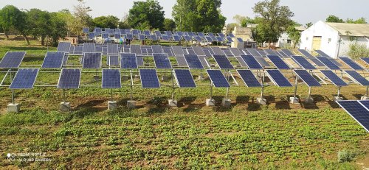
What is agrivoltaics?
Agrivoltaics – It is a perfect combination of solar panels and food crops on the same land to maximize the land use. It involves combining crops with photovoltaic panels, installed with enough height to allow farm machinery to pass underneath. Such height is also favorable to the crops that need moderate amount of sunlight.
The challenge is to generate crops and energy simultaneously and without conflict.
Source: Research Communications, University of Arizona. (February 26, 2018).

Slide 5
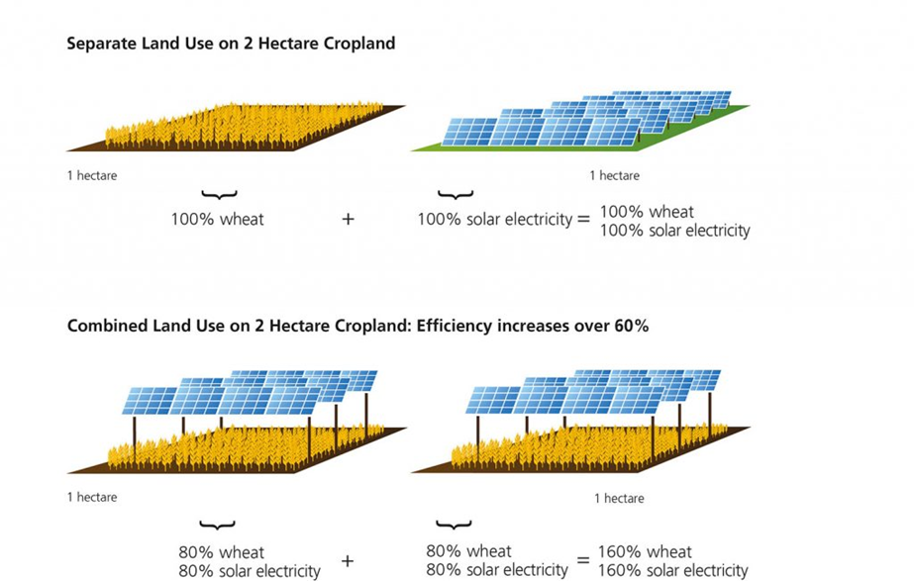
How can solar energy and agriculture work together?
First, researchers tried to supply power demand for agriculture using solar panels and crop on separate land as shown in the figure.
Using large area of land for solar farms will increase competition for land resources as food production demand and energy demand are both growing.
Researchers tried to mount the panels above crops at some height on the same piece of land, which successfully increased food and energy production by approx. 60%.

Slide 6
Few-n Solution
Agrivoltaics can be an eco-friendly solution to the Food-Energy-Water (FEW) Nexus.
The plants are protected by the solar panels from the worst of the midday sun’s rays. It helps to produce a temporary evaporative coolers on the landscape. They take up carbon for photosynthesis, while letting water escape from their leaves and create a cooler microclimate.
The solar panel modules can lose efficiency while operating under the blazing sun. The panels perform at a higher level can also be protected by this cooler microclimate afforded by the plants. The panels, in turn, protect the plants from sunburn and dehydration.
At the end, it results a better crop yield and more efficient performance of the solar array.
Source: (2018), Agrivoltaics: What is it and how does it work? – N-Sci Technologies (nsci.ca)

Slide 7
Why agrivoltaics?
Because Agrivoltaics allows us to produce food and energy both on the same land.
These are the benefits of adapting Agrivoltaic System:-
Food - Crop production increased by 60%
Energy - Improved renewable energy production
Water - Reduce water consumption
Therefore, It reduce the stresses on the FEW-Nexus
No more emissions of greenhouse gases
Income throughout the year
Agrivoltaics system is beneficial for a long term use
.

Slide 8
Uses of solar power in Agriculture
Solar water pumping
Solar drying
Refrigeration for food preservation
Farmer’s own house electricity consumption
Energy purchasing agreement with local residential and industrial estates
Sprinkler
When mounted vertically, like fences facing east and west, they produce peak power in the morning and afternoon, unlike horizontal panels that peak at midday.

Slide 9
Challenges of agrivoltaics?
High initial set-up cost of solar panels
Partial shed on the crops under the panels
Limited crops are compatible with agrivoltaic
We cannot produce highly demanded crops like Wheat and Rice
Many Farmers Unaware Of Benefits
Regular maintenance cost of the panels
Only long term beneficial
.

Slide 10
Solutions
High initial set-up cost - The government of India is providing up to 90% subsidy to farmers to install solar panels and solar water pump.
Unawareness - Government should do something like print news, make announcements, to spread the awareness of subsidies and benefits to the farmers in adapting the agrivoltaic system.
Maintenance cost of the panels - A good quality solar panels has averagely 25 years of life (not to worry for a long time)
.

Slide 11
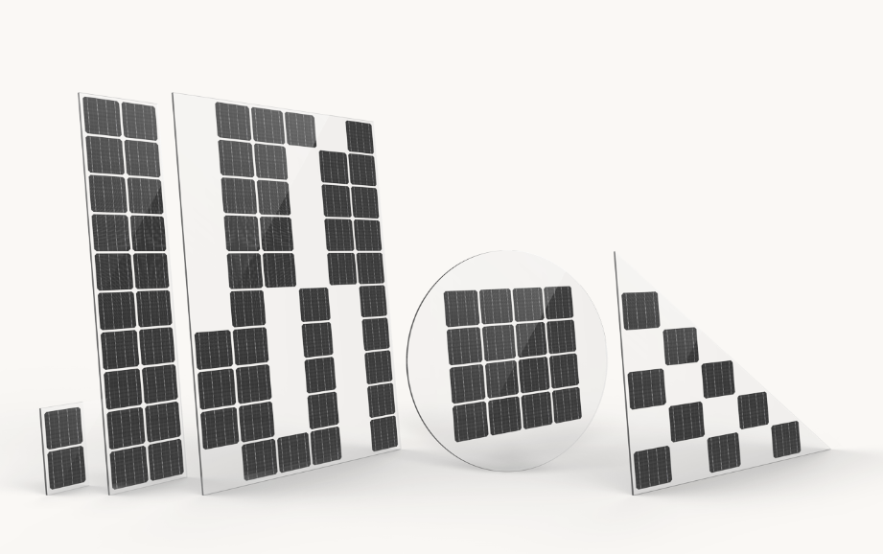
Solutions
Two possible solutions to shed on the crops due to panels
We can set-up the solar panels at some effective height and angle such that crops get enough sunlight.
We can make some customizations to the solar panels
Shape and size
Color of glass
Glass transparency
Cell arrangement
Gap differentiation
Thickness
Efficiency

Slide 12
Future of Agrivoltaics
Solar energy increased its share of global electricity generating capacity by 50% in 2016 alone, overtaking growth in wind, gas and other renewable technologies.
The cost of solar photovoltaic cells – the major capital cost in solar installations using that technology – has fallen 80% since 2008.
Adeh (2018) concluded that we can increase water efficiency of the soil upto 328% under the solar modules for some crops.
Zheng (2021) concluded that Even-lighting Agrivoltaic Systems (EAS), which has an improved grooved glass plate design provide more light to the crops below, has the potential to increase farmers’ income by an average of 5.14 times over that of non-agrivoltaic systems and even improvement in crop quality.
Source: Angeline Hannachi, (Nov 2021), Exploring the Benefits and Challenges of Agrivoltaic Adoption

Slide 13
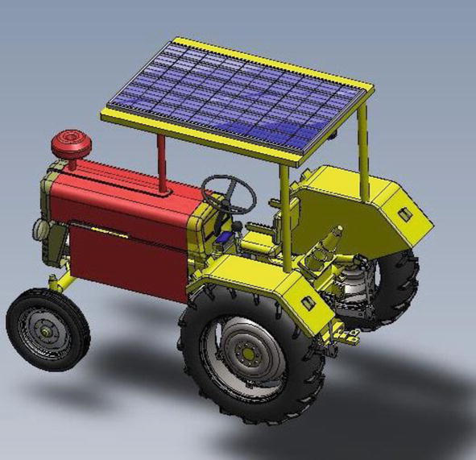
Future scope
Tractor – an important role in agriculture
A tractor provides power to perform many tasks, including plowing, seeding, planting, fertilizing, spraying, cultivating, and harvesting crops at farms.
Tractor for transportation
Common tractors use diesel oil but solar tractors will use electrical energy from solar cells.
Source: Ghulam Hasnain Tariqe et al. (June 2021), Solar Technology in Agriculture

Slide 14
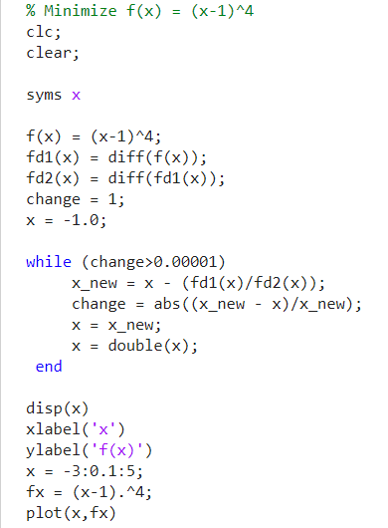
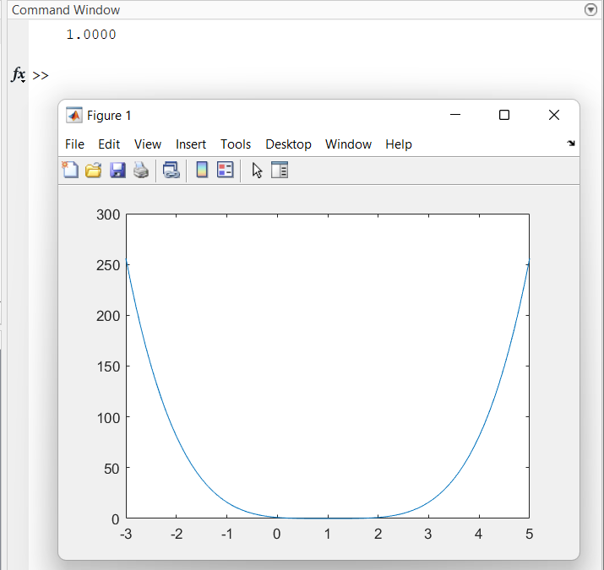
Optimization – Newton’s Method

Slide 15
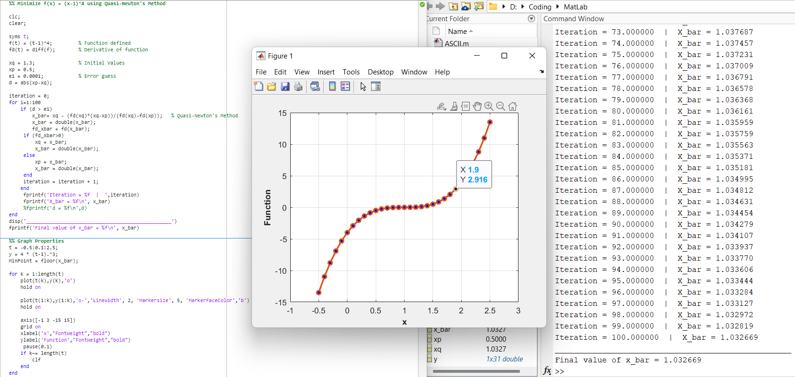
Optimization – Quasi-Newton’s Method

Slide 16
Thank You !

